Slide 1
Data Protection
Definition

Slide 2
Derivation of the GDPR
misuse of data
Data Protection
Right to informational self-determination
privacy
Personal rights in data processing
Notes:
Slide content:
This ‘context slide’ shows which rights of a person are included in the right to data protection. This can be helpful when data controllers have to weigh up interests in relation to data processing in practice. This is because the data subject's interest in not having their data processed is based on these rights.
The individual rights briefly explained:
(general) right of personality: Fundamental right that serves to protect a person's personality from interference with their life and freedom. It also includes the right to informational self-determination and the right to privacy
Right to informational self-determination: every person has the right to decide for themselves on the disclosure and use of their personal data.
Right to privacy: the right of a person to freely organise their private life without unjustified interference from the state or other persons
Protection against abusive data processing: the purpose of data protection

Slide 3
Derivation of the GDPR
Right to data privacy
→ “EU-fundamental right”
Ensuring the free flow of data
Both have equal status!
Equivalent and uniform level of data protection required in all member states
Regulation directly applicable!
Notes:
Slide content:
Another ‘context slide’. It shows the reason why the GDPR was enacted by the EU legislator. In addition to protecting the aforementioned rights of natural persons, the EU legislator is also obliged to ensure the free movement of data within the EU. In order to fulfil this obligation, the EU legislator has created the GDPR as directly applicable law. This also prevents the free movement of data from being hindered due to inconsistent data protection regulations in the respective member states.
This slide helps to understand the existence of the GDPR as directly applicable law.

Slide 4



Scope of the GDPR (Art. 3 GDPR)
Where does the GDPR apply?
When does the GDPR apply?
Who does the GDPR apply to?
What does the GDPR apply to?
all natural or legal persons who process data
Data processor is based in the EU
The GDPR applies to all data, regardless of age!
Fully or partially automated processing of personal data
Non-automated processing if data is (or is to be) stored in a file system
Illustrations: “local” by Circlon Tech, “Time” by Nursila from Noun Project is licensed under CC BY 3.0
Notes:
Slide content:
Laws always have what are known as scopes of application, i.e. the areas to which they apply.
When data is processed within the EU, the GDPR applies, even if the data relates to individuals outside the EU
This also applies to legacy data
It also applies to natural persons (you and me) and legal persons (e.g. companies) who process data
It applies for the Processing of personal data -> collection, storage, editing, deletion, destruction

Slide 5
Territorial scope of application (Art. 3 DSGVO)
Where does the GDPR apply?
Data processor is based in the EU
→ even if the processing takes place outside the EU!
“Establishment Principle”
→ Responsible parties outside the EU offer goods to persons within the EU/observe their behaviour
→ important for cloud-providers
Illustration: “local” by Circlon Tech from Noun Project is licensed under CC BY 3.0
Notes:
Slide content:
The territorial scope of application results from Art. 3 GDPR. It determines where the GDPR applies. It shows what applies if the data controller is based inside or outside the EU.
Registered office within the EU: the GDPR ALWAYS applies to data controllers, regardless of whether the specific data processing takes place inside or outside the EU
Registered office outside the EU: the so-called ‘market place principle’ applies -> according to this, it is not decisive where a company is based, but whether it offers its goods on the EU internal market and thus affects EU citizens. Cloud providers such as Microsoft or Google are cited as examples here. They must comply with the GDPR even though they are based in the USA.

Slide 6
Material scope of application (Art. 2 DSGVO)
What (which circumstances) does the GDPR apply to?
Fully or partially automated processing of personal data
Non-automated processing if data is (to be) stored in a file system
Notes:
Slide content:
The material scope determines the circumstances to which the GDPR applies. It arises from Art. 2 para. 1 GDPR and applies to any wholly or partially automated processing of personal data and to non-automated processing if the data is stored in a file system.

Slide 7

identification vs. identifiability
identification:
Identity results directly from the information itself
Bsp: Brigitte Meyer
identifiability:
Identity results from linking several pieces of information
eg.: Assignment by means of identifier, identification number, location
Notes:
Slide content:
The difference between identification and identifiability of a person is explained here. Art. 4 no. 1 GDPR defines ‘personal data’ as information relating to an identified or identifiable person.
Art. 4 no. 1 GDPR refers to an identified or identifiable person
‘Identification’ is quite simple: identity is derived directly from the information itself.
‘Identifiability’ is more difficult to grasp. Identity results from the combination of several pieces of information

Slide 8
identifiability
When is identifiability assumed?
EU case law follows a relative approach:
Can the data controller reasonably identify the data subject with the means at its disposal and without disproportionate effort?
Notes:
Slide content:
When identifiability can be assumed depends on whose knowledge is taken as a basis: absolute approach = the knowledge of every third party must be included; relative approach = it must be assessed from the perspective of the data controller -> can it reasonably identify the data subject with the means at its disposal (e.g. not illegally) and without disproportionate effort? -> Here again, additional knowledge of third parties may be required if the data processing centre can access it.
When examining the effort involved: costs and time required, technologies available at the time of processing and technological developments must be taken into account
Consequence of this: case-by-case decision!!!
When identifiability can be assumed depends on whose knowledge is taken as a basis: there are two approaches to this in jurisprudence.
1. absolute approach = the knowledge of every third party must be taken into account;
2. relative approach = it must be assessed from the perspective of the data processing organisation -> can it reasonably (i.e. not illegally) identify the data subject with the means at its disposal and without disproportionate effort? -> Here again, additional knowledge of third parties may be required if the data controller can access it.
Since EU case law follows the relative approach, this is also used as the basis for the solution to the case study.
When examining the effort involved, account is taken of Costs and time required, technologies available at the time of processing and technological developments to be taken into account
Consequence of this: Case-by-case decision!!!

Slide 9
personal data vs. factual data
When does a factual date become a personal date?
Are there individualising identification features?
Does the factual date in context affect the legal, economic or social relationships of a natural person?
Are they suitable for describing their individual circumstances?
eg: handwritten examination answers reflect the level of knowledge and competence of the examinee and calligraphic information
Notes:
Slide content:
The difference between personal and factual information is explained here. This is closely related to the question of the identifiability of persons
Factual data = data that provides information about an object: E.g. maximum power of a car; parcel no. of a plot of land
However, factual data can become personal data if there are individualising identification features or the factual data has an impact on the legal, economic or social relationships of a natural person in context.

Slide 10
personal vs. sensitive data
personal data
all information relating to an identified or identifiable natural person
sensitive data
special categories of personal data that are subject to special processing conditions
personal
sensitive data
data
Quelle: Europäische Kommission
Notes:
Slide content:
This slide is intended to clarify the terms ‘personal data’ and ‘sensitive data’, as these are used synonymously in practice. The term ‘sensitive data’ is also used in practice for circumstances outside the scope of the GDPR (e.g. with regard to trade secrets). Its meaning should therefore be explained in the context of the GDPR.
When the term ‘sensitive’ data is used (here), it refers exclusively to data in accordance with Art. 9 GDPR!

Slide 11
personal vs. sensitive data
personal
sensitive data
sensitive data
in the GDPR-context: Art. 9
data revealing racial or ethnic origin, political opinions, religious or philosophical beliefs
trade union memberships
genetic, biometric data, for the purpose of uniquely identifying a natural person
health data
data concerning a natural person's sex life or sexual orientation
data
Important!
business/ contract secrets are not sensitive data according to the GDPR!
Notes:
Slide content:
‘Sensitive data’ within the meaning of the GDPR refers to the special categories of personal data in accordance with Art. 9 para. 1 GDPR. This includes, for example, health information and biometric data, but also information about political opinions or religious or philosophical beliefs.
Even outside the context of the GDPR, there is data that can be described as ‘sensitive’.
may also contain personal data, but not necessarily.

Slide 12
natural person vs. legal person
natural Person
Brigitte Mayer, farmer
Is there a difference
when it is the Brigitte Mayer ltd.?
legal entity
Association of persons that is vested with rights and obligations by law (legal entity)
Apples & Pears Ltd.
Notes:
slide content:
This slide explains the difference between natural and personal information and defines the terms.
The GDPR describes personal data as information relating to a specific natural person.
Legal persons are associations of persons who are vested with rights and obligations by law (so-called legal entities). They are not covered by the GDPR. It is therefore generally possible to process the data of a legal entity without having to comply with the GDPR. Examples are companies like farms.
The participants will be asked the open question of whether the GDPR must be observed in exceptional cases when processing the data of legal entities if their name allows conclusions to be drawn about a natural person. (the answer ist yes)

Slide 13

Personal Data
What applies regarding agricultural data?
personal data = data that identifies natural persons, not companies!!
BUT Careful! agricultural farms are often not just companies,
but homes of natural persons!
AND Careful! If name of the farm = name of the farmer
examples, that can contain personal information:
interviews (e.g. with farmers), geolocation, drone data (e.g. video of persons)
Sources: GDPR, Lea Singson (2023); Illustration: “data” by jamzuri is licenced under CC BY 3.0
Notes:
Slide content:
‘Personal data’ means any information relating to an identified or identifiable natural person (‘data subject’); an identifiable natural person is one who can be identified, directly or indirectly, in particular by reference to an identifier such as a name, an identification number, location data, an online identifier or to one or more factors specific to the physical, physiological, genetic, mental, economic, cultural or social identity of that natural person.
Attention: if a legal entity, such as an agricultural farm, has a name that includes the name of a natural person, that person can be identified in this way. Therefore, if it is not 'Apples & Pears Ltd.' but 'Brigitte Mayer Ltd.', it can constitute personal data.
Typical agricultural data that can contain personal data is:

Slide 14



Personal Data in agricultural science
Illustrations: “drone” by Gendis Studio, “interview” by seniman, “geospacial technology” by Profit0101 from Noun Project is licensed under CC BY 3.0
Notes:
Slide content:
This slide shows typical examples where personal data appear in agrosystem research.
Interviewdata:
e.g. interviews with farmers – provided they are not conducted anonymously via an anonymous survey
Drone data:
It may happen that people are “accidentally” recorded by the drone.
Question: Are they identifiable according to the definition?
Based on the angle of the shot: from above vs. from the side
→ Are no faces or other clearly identifying features (e.g. voice, distinctive clothing) recognisable?
Geolocation - see next slide

Slide 15
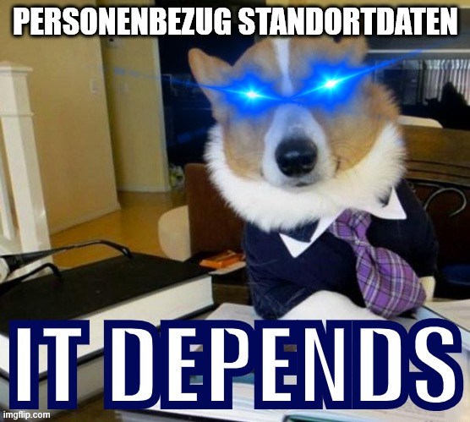
Geolocation data
On the one hand…
Factual data, no personal references
On the other hand…
Location data may, under certain circumstances, identify a natural person
Illustration: GIF created using meme generator by imgflip.com;, “geospacial technology” by Profit0101 from Noun Project is licensed under CC BY 3.0
Notes:
Slide content:
Example of location data:
Soil samples are taken from arable land owned by a natural person (landowner) and leased to another person (tenant).
The samples are analysed for soil quality and soil health and published with coordinates (as part of a supra-regional research project). Conclusions can be drawn about the owner, the tenant and their use of, for example, fertilisers, as well as changes in the value of the property.
As mentioned above: location data is factual data in itself. But in practice, it is often a ‘source of concern’ for many researchers
here, the favourite phrase of all lawyers applies: it depends!
Note: this has not yet been decided by the highest court, which is why handling varies considerably in some cases (primarily due to differing instructions from the respective federal data protection commissioners)
very important: in agricultural research and related fields, contact is often exclusively with companies: if no natural person lives, thrives or breathes at the site, the GDPR does not apply!!
Two exceptions to this: if the name of the legal entity is determined by natural persons, the GDPR applies (+); or if natural persons live on the property at the same time (often the case with family-run businesses)
If the property is ‘subsumed’ within a collection of other properties, then there is no personal reference (-)

Slide 16

Data Protection - Applicability of GDPR
please go to menti.com
enter Code: XXX XXX
or scan the QR Code
Assess the various scenarios according to whether the GDPR applies here.
replace me!
Notes:
Note: Register for a free account on mentimeter.com or a similar tool and create slide with the question "Does the GDPR apply?" and add the different scenarios, you find in Worksheet 11-02-07. Generate a QR Code to your menti and add it, together with the Menti Code, into this slide. For online training, consider creating a poll using your conference tool.

Slide 17
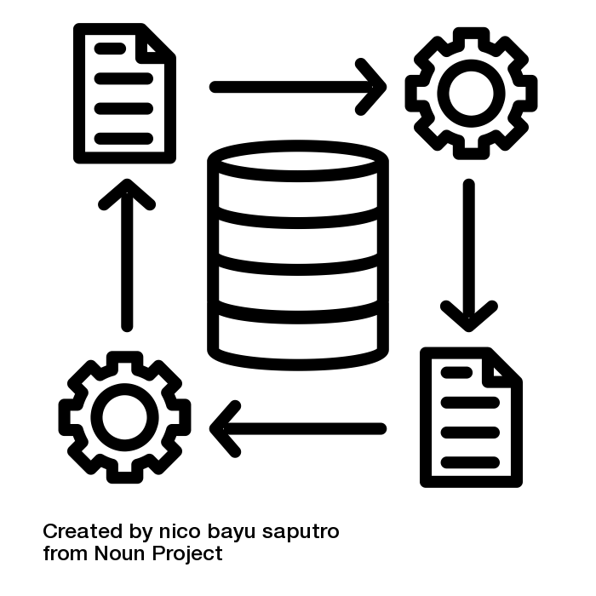
Data processing
Any operation (or set of operations) which is performed on personal data, whether or not by automated means
Data processing must fulfil certain requirements!
Illustration: “data processing” by nico bayu saputro is licensed under CC BY 3.0
Notes:
Slide content:
the following slides show the legal basis of data processing. But was it data processing according to GDPR?
Data processing is a very broad term! It includes everything that can be done with data -> collection, storage, organisation, use, deletion, modification
Automated means: everything for which information technology infrastructure (hardware, software, transmission networks) is used -> everything that can be done with personal data using IT systems
Non-automated means: e.g. handwritten notes

Slide 18
When is data processing lawful?
Art. 5 GDPR names everything,
a processor needs to pay
attention to
Data processing must fulfil certain requirements!
Illustration: “data processing” by nico bayu saputro is licensed under CC BY 3.0

Slide 19
When is data processing lawful?
purpose limitation
lawfulness
integrity & confidentiality
fairness
Art. 5 GDPR
accountability
transparency
storage limitation
data minimisation
accuracy
Notes:
Slide content:
Art. 5 GDPR is a central standard of the regulation. It sets out the principles that data processing must fulfil in order to be permitted. When it comes to justifying lawfulness as a data processor and making decisions, it is always a question of examining the so-called proportionality of actions and balancing interests.
Regarding Art. 5 GDPR:
Lawfulness means: only on the basis of consent or other legal legitimisation. These legitimisations ultimately result from Art. 6 GDPR
fariness means: duty to take into account the interests of the data subject - keyword: fairness of processing
Transparency means: data subject must be able to understand data processing retrospectively
purpose limitation contains 2 principles:
Processing must be carried out for specified, clear purposes
-> no processing “in stock”
-> The processing purposes determine the necessity, the legal basis in accordance with Art. 6 GDPR and the information obligations in accordance with Art. 13 et seq. GDPR and how transparent the data processing is
No incompatibility with the purpose of the collection -> purpose limitation in the narrower sense -> Exceptions for scient. research
Data minimisation contains the necessity for the processing to be relevant for the purpose, the processing needs to be a necessary and an adequate measure:
Relevant for the purpose means: Suitability - does the data processing fulfil the intended purpose?
Necessary measure means: Necessity - Is there a lesser means? e.g. anonymous collection in surveys. Is unnecessary data collected?
Adequate means: Have the processing interests been weighed against the interest of the data subjects not to process data and does the processing interest prevail?
accuracy means: The accuracy must exist both with regard to facts and with regard to conclusions from them/forecasts/value judgements
in regard to storage limitation: There is an exception for scientific research. There is an exception for scientific research if compensation is provided in the form of guarantees.
integrity and confidentiality also includes protection against unintentional access/loss/destruction - it does not matter whether the person responsible is responsible for the loss etc. or whether there was ‘force majeure’.

Slide 20
Legal Basis
of the data processing

Slide 21
Art. 6 GDPR
determines the legal grounds on which data processing can be built upon.
Reminder: Principle of lawfulness(Art. 5 Abs. 1 a)
Relevant for research i.p:
consent
necessary for the performance of a contract
necessary for the performance of a task in the public interest
legitimate interest
no hierarchy!
Notes:
Slide content:
Only those grounds of legality that could be relevant for the target group are presented here.

Slide 22
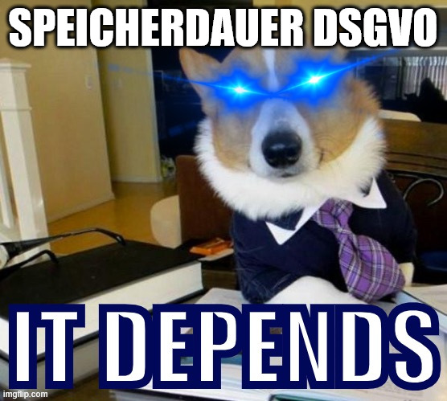
Storing
Storage only lasts as long as it is necessary for the purposes of data processing!
There is no fixed retention period; it depends on the specific individual case!
Notes:
Slide content:
The GDPR does not specify any fixed retention periods, as the required retention period always depends on the specific processing context. The GDPR therefore links the storage period exclusively to the processing purpose.

Slide 23

Erasure
Art. 17 GDPR
processing originally lawful
Loss of purpose → Erasure then not only at the request of the data subject, but independently of it!
Revocation of consent
Objection to processing acc. Art. 21 GDPR
immediate erasure necessary
Notes:
Slide content:
The right to erasure arises from Art. 17 GDPR
-The right to erasure is linked to the right to be forgotten.
There are various constellations in which the controller may be obliged to erase
The first constellation is the one in which the data processing was originally lawful. Data must be erased if
-the purpose of processing has ceased to exist or has been fulfilled. In this case, the data must be erased regardless of a request from the data subject.
-If consent has been withdrawn: only if data processing was based on consent. If the processing was based on another legal basis (see Art. 6 GDPR), there is no right to cancellation.
-an objection to data processing has been lodged, which arises from the particular situation of the data subject. In this case, the controller can check whether there are overriding legitimate grounds for the processing despite the objection.

Slide 24
Erasure
Art. 17 GDPR
Processing unlawful from the start
Erasure required to fulfil a legal obligation
immediate erasure necessary
Notes:
Slide content:
The second constellation is one in which the data processing was unlawful from the outset. This must be assessed at the time of the erasure request. Data processing that was initially unlawful can therefore become lawful.
The third constellation is that the erasure is necessary to fulfil a legal obligation. This arises from national law.

Slide 25
Science and data privacy
Exception to the purpose limitation principle (Art. 5 para. 1 b)
Permissibility of further processing for scientific research purposes
  Compensation through obligation to create protective guarantees (Art. 89 para. 1)
Exception to the principle of certainty: Keyword “Broad Consent”
Exemption from the erasure obligation (Art. 17 para. 3 d)
Notes:
Slide content:
Science and data protection
This slide discusses some of the special features that arise for science in relation to data protection. Here, we have limited ourselves to presenting the aspects relevant to the participants' domains.
The exception to the purpose limitation principle according to Art. 5 para. 1 lit. b) GDPR: if data is further processed for the purpose of scientific research, it is assumed that this further processing is never incompatible with the original purpose of collection. In return, however, the controller must then comply with the data protection safeguards specified in Art. 89 GDPR. In this context, the catalogue of measures in Section 22 para. 2 sentence 2 BDSG is instructive.
Exception to the principle of certainty: Recital 33 of the GDPR states that in the field of scientific research, consent to data processing can also be given for specific areas and not only for specifically named purposes.

Slide 26
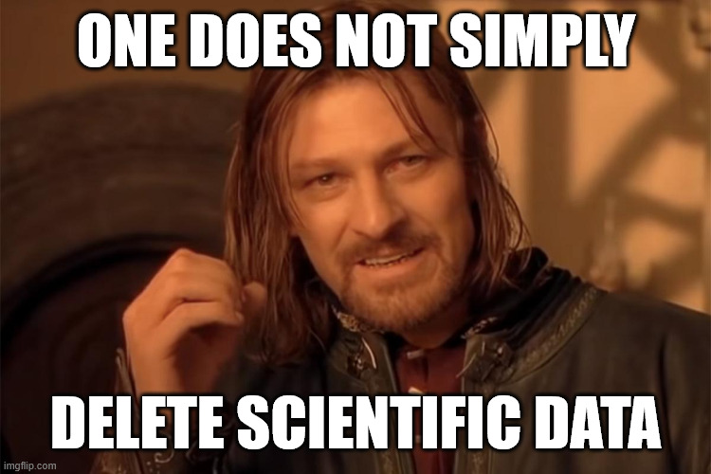
Science and data privacy
Exception to the purpose limitation principle (Art. 5 para. 1 b)
Permissibility of further processing for scientific research purposes
  Compensation through obligation to create protective guarantees (Art. 89 para. 1)
Exception to the principle of certainty: Keyword “Broad Consent”
Exemption from the erasure obligation (Art. 17 para. 3 d)
if realisation of the processing objectives is likely to be impossible or seriously impaired as a result!
Illustration: image from imgflp.com- free to use acc. to copyright exeptions
Notes:
Slide Content:
Exception to the erasure obligation pursuant to Art. 17 para. 3 lit. d) GDPR: If processing is necessary for scientific research and erasure is likely to render impossible or seriously impair the achievement of the specific research purposes. In this case, the guarantees of Art. 89 GDPR must be complied with.

Slide 27
Data Protection
Anonymisation & Psydonymisation

Slide 28

Anonymisation
Anonymisation:
Modification of data with the result that it can no longer be linked to the personal information / only with unreasonable effort.
The GDPR does not apply
Illustration: “undercover” by Luis Prado from Noun Project is licensed under CC BY 3.0
Notes:
Slide Content:
Definition of anonymisation:
Personal reference is completely removed
As can be seen in the definition, it is not necessary that identification is no longer possible. This is called relative anonymisation and means that re-identification can be reduced below a certain threshold.
Indications of when anonymisation is unlikely to be successful: a small data set, the individual data categories are so different that individual persons can be filtered out
Consequence of anonymisation: GDPR does not apply to the anonymised data because there is no longer any personal data!

Slide 29

Pseudonymisation
Pseudonymisation:
Tool for removing personal information from a data set.
Direct or indirect identifiers are separated from personal data, stored separately and replaced by IDs.
GDPR applies!
Illustration: “pseudonym” by ismail abdurrasyid from Noun Project is licensed under CC BY 3.0
Notes:
Slide Content:
Definition of pseudonymisation:
there remains a possibility of assignment
Consequence of pseudonymisation: the GDPR remains applicable to those persons who have/can reasonably have access to the identification key.

Slide 30
Pseudonymisation vs. Anonymisation
Pseudonymisation
data re-identifiable
Anonymisation
data not re-identifiable
wrong anonymisation = pseudonymisation

